Slide 1
Creating a Recommendation System for Amazon Marketing Team
This presentation provides an overview of a project to create a recommendation system for the Amazon marketing team to improve post-purchase email engagement.

Slide 2
Overview
A collaborative approach was taken, using existing ratings to make recommendations.
We are a team of internal data scientists at Amazon.
The project aims to create a recommendation system for the Amazon marketing team to send targeted recommendation e-mails.
The project focuses on post-purchase email engagement for beauty products.
Personalized, relevant, and timely recommendations are important for customer re-engagement.

Slide 3
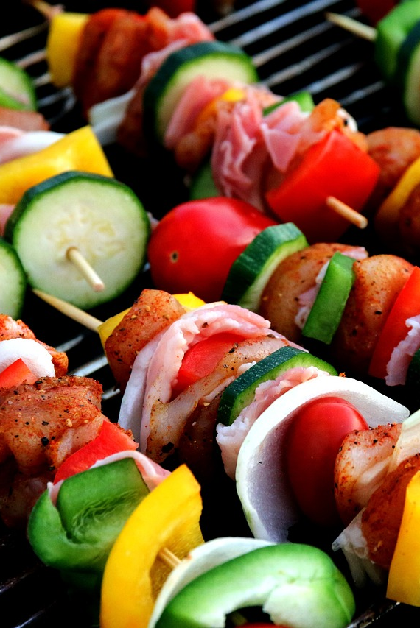
Business Problem
Amazon's marketing team wants to improve postpurchase email engagement.
Customers open postpurchase emails 17% more often than other automated emails.
Reengaging customers at post-purchase stage can lead to future purchases.
Content in postpurchase emails must be engaging and relevant.
A recommendation system can help select personalized product recommendations for customers.

Slide 4
Data Understanding and Preparation
Reviews were given on a scale of 1-5, with a majority of reviews receiving a rating of 5.
Data was collected from Amazon Beauty product reviews and meta data.
Two separate JSON files were used: 5-core dataset and dataset with 198,502 reviews.
Review data contained 22,363 reviewers and 12,101 unique products.
The smaller dataset was used for this project.

Slide 5

Review Distributions
A majority of reviews received under 10 ratings.
Distribution of product reviews varies.
The goal is to make accurate recommendations despite the varying review distributions.
The recommendation system should not recommend products that the customer has already purchased.
Review distributions impact model performance.

Slide 6
Thank you for your time and attention 🙂

Slide 7
Presentation: Reviews per Product
This presentation focuses on the distribution of reviews per product and the recommendation system used to return items in the Beauty subcategory.

Slide 8
Reviews per Product
Majority of users rated under 10 products
Distribution of the number of reviews completed by each user
Insights about user engagement and activity

Slide 9
Ratings per User
259,204 unique products in Meta Data
Identified six subcategories: Skin Care, Tools & Accessories, Makeup, Hair Care, Bath & Body, and Fragrance
Focused on Beauty subcategories for recommendation system
Importance of subcategories for personalized recommendations

Slide 10
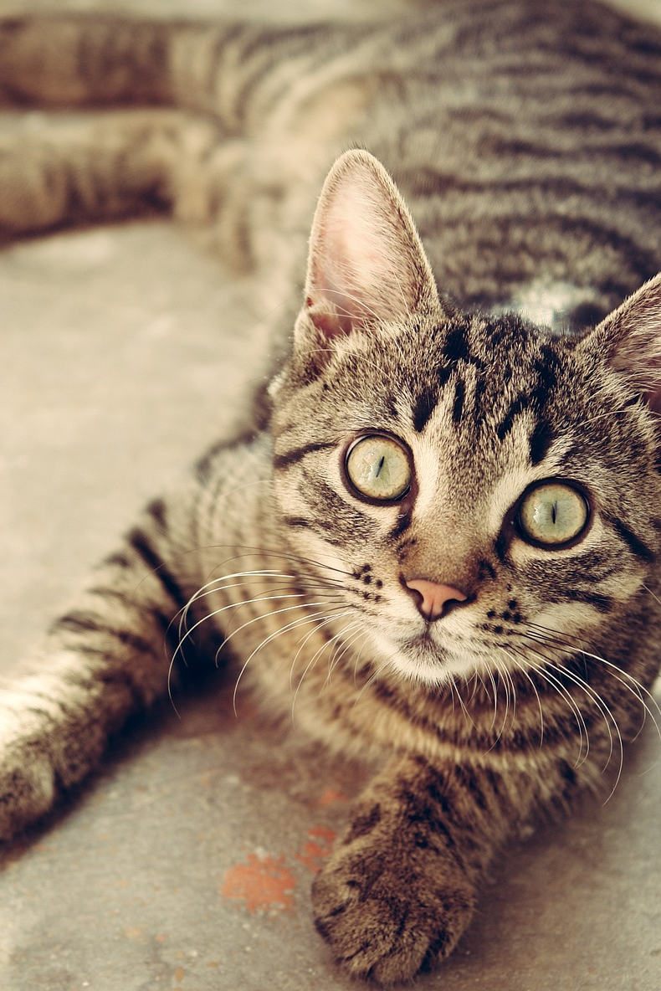
Data Cleaning and Selection
Selected columns for surprise model: reviewerID, asin, and overall
Unique reviewer ID, product ID, and rating
Scale of 15 for overall rating
Importance of relevant data selection for accurate predictions

Slide 11
Model Selection and Evaluation
Top 3 models based on Test RMSE: SVDpp, SVD, and Baseline Only
Utilized Normal Predictor model as initial model
Assessed various models for further exploration
Grid search for hyperparameter optimization
SVD model with (n_factors=2, n_epochs=20, biased=True) as best model

Slide 12
Final Collaborative Filtering Models
Order recommendations by highest predicted_rating
Input reviewerID and number of recommendations
Facilitates personalized recommendations for users
Returns ASIN, Product Name, Description, Image, and predicted_rating

Slide 13
Additional Final Model
Useful for promoting specific items at certain times
Input reviewerID, number of recommendations, and product category
Returns ASIN, Product Name, Description, and Image
Enhances targeted marketing strategies

Slide 14
Thank you. Please feel free to ask any questions. 😄

Slide 15
Final Model Evaluation
This presentation provides an overview of the final recommendation model and its evaluation.

Slide 16
Model Evaluation
The final recommendation model using SVD yielded a RMSE of 1.08.
This score is more than half a point drop from our baseline model.
This means that, on average, our predicted review scores for Amazon buyers were 1.08 points off of the true value of review scores.
On a review scale of 1-5, this improvement is considered significant.

Slide 17
Personalization Features
No repeat products: The model will not recommend items that the buyer has already purchased.
Prioritizes the best match for the buyer: It will deliver the top predicted reviews for a buyer.
Subcategory filtering: Allows filtering beauty products based on six subcategories.
Image retrieval: Converts URL to an image and delivers alongside recommended titles and descriptions.

Slide 18
Limitations
Cold start problem: Prior reviews from users are needed to offer recommendations.
Skewed dataset: Nearly 60% of all reviews were rated 5 points, which may affect the accuracy of lower rated items.
Misclassified products: Dataset often miscategorizes products in subcategories, leading to recommendations of misclassified products.
Indiscriminate reviewers: The model does not handle reviewers who rate all products the same.

Slide 19

Next Steps
Investigate dataset bias: Determine if high ratings are consistent with Amazon buyer behavior.
Address indiscriminate reviewers: Send a separate survey to these buyers to capture their preferences.
Solve the cold start problem: Add a contentbased approach to offer recommendations without prior reviews.
Implement standardized classification: Improve the accuracy of subcategory predictions by implementing a standardized classification method.

Slide 20
Conclusion
Implement recommendation tools quickly and easily
Offer personalized recommendations for users
Increase user engagement and purchases

Slide 21
Thank you for your time and attention 🙂

